Slide 1
Team SCRANTON
🅰for🍎
Rajat Upadhyay
Rishabh Raizada

Slide 2
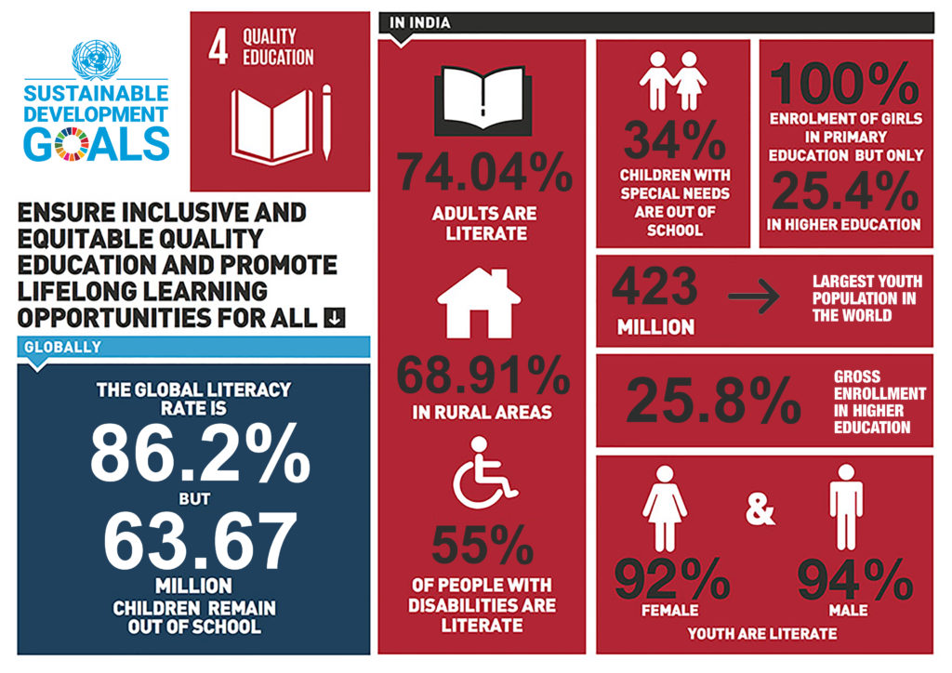

Slide 3
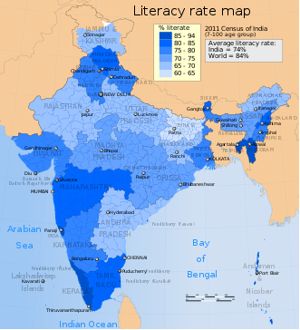
References and statistics
https://in.one.un.org/page/sustainable-development-goals/sdg-4/
https://www.campaignforeducation.org/en/who-we-are/the-international-education-framework-2/the-sustainable-development-goal-4/sdg4s-10-targets/?gclid=EAIaIQobChMIhZvcr7Ct5wIVigsrCh3h9wSpEAAYASAAEgIbX_D_BwE
https://en.wikipedia.org/wiki/Literacy_in_India

Slide 4
Idea & Working

Slide 5
Tech stack
1. Front end:
HTML, CSS, Bootstrap, JAVASCRIPT
2. BACK end:
MongoDB, NodeJS, ExpressJS.
3. APIs
Microsoft AZURE speech SERVICE
MAPMYINDIA

Slide 6
What’s next?
Azure Immersive Reader
Fully voice operational
Navigation message about events
Image to text checking
Multilingual & Regional accent recognition
Scale to toddlers and students

Slide 7
THANK YOU

